Slide 1
Framework for bigdata storage and security using MongoDb

Slide 2
UNSTRUCTURED DATA in bigdata
Unstructured data is a generic label for describing data that is not contained in a database or some other type of data structure .
Unstructured data can be textual or non textual.
Textual unstructured data is generated in media like email messages, PowerPoint presentations, Word documents, collaboration software and instant messages.
Non-textual unstructured data is generated in media like JPEG images, MP3 audio files and Flash video files.

Slide 3
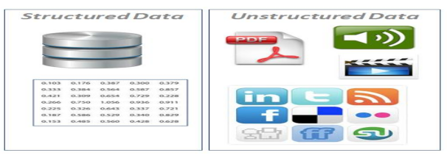
Structured vs Unstructured data

Slide 4
MongoDb
Mongo DB is an open source database that uses a document-oriented data model.
Mongo DB is one of several database types to arise in the mid-2000s under the NoSQL banner.
Instead of using tables and rows as in relational databases, Mongo DB is built on an architecture of collections and documents. Documents comprise sets of key-value pairs and are the basic unit of data in Mongo DB. Collections contain sets of documents and function as the equivalent of relational database tables

Slide 5
Proposed System
Scope of the project
The previous works have been dealt with using the clustering method to store the data’s.
In this project going to use Mongo DB to store the large amount of unstructured data.
Mongo DB is very consistent to store the unstructured data using a sharding technology.
Security implement using mongo db

Slide 6
Proposed System
Objectives
To extract the unstructured data from the source.
To managing the queries to the categorization of the data.
For the data storage first create the shard cluster environment and after that store the large amount of unstructured data into the MongoDB database.
Security based on parse tree

Slide 7
A Parse Tree-Based NoSQL Injection Attacks Detection Mechanism
In this paper, we based on semantic structure analysis of execution statements to propose a detection approach using parse tree.
Based on this approach, we focus on MongoDB to propose a dynamic NoSQL injection attacks detection mechanism in the web environment called DND.
It does not require access to or modifying source codes, rewriting source codes with extra libraries, or complex assisted devices. Finally, the experimental results are shown that DND has high accuracy rates, low false positive rates, and low response time.

Slide 8
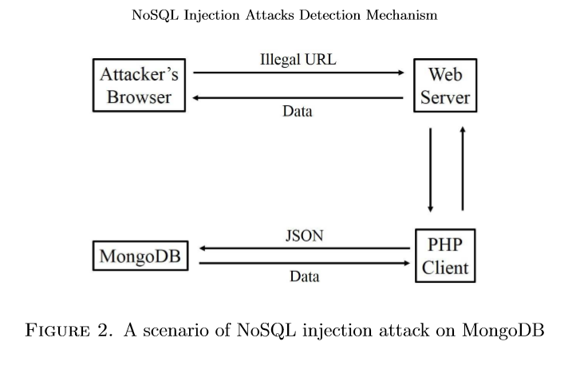

Slide 9
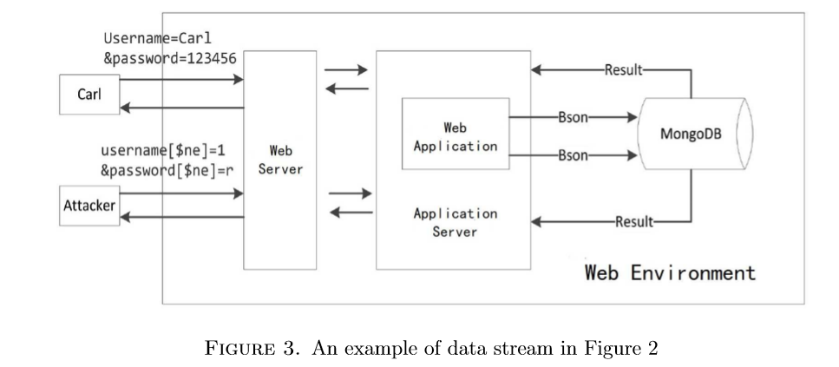

Slide 10
REFERENCES
R. Cattell, Scalable sql and nosql data stores, Acm Sigmod Record, vol. 39, no. 4, pp. 12–27, 2011.
Sahaﬁzadeh and M. A. Nematbakhsh, A survey on security issues in big data and nosql, Advances in Computer Science: an International Journal, vol. 4, no. 4, pp. 68–72, 2015.
https://www.tutorialspoint.com/python/python_processing_unstructured_data.html
https://www.researchgate.net/publication/289519291

